Slide 1
Business Analytics Project-Ready Dataset (Price Optimization)
Course: Business Analytics Capstone
Student: Rosemary Iheme
Date: 24th September 2025

Slide 2
Project Context
Retail pricing decisions often rely on intuition or competitor matching.
Goal: Use data analytics to optimize pricing for maximum revenue and profitability.
Deliverable for Milestone 1: a project-ready dataset prepared for modeling. (McKinsey & Company, 2021; Phillips, 2021)

Slide 3
Data Sources
Primary Source: Kaggle Retail Pricing Optimization dataset (Suddharshan S, 2023).
Includes: product IDs, categories, historical prices, units sold, and promotional indicators.
Chosen because it:
Matches project objective (pricing optimization).
Provides sufficient scale for modeling demand elasticity.
Is publicly available and ethically usable. (Suddharshan, 2023)

Slide 4
Data Collection Tools & Methods
Tools Used: Python, Pandas, NumPy, Jupyter Notebook.
Dataset hosted on GitHub for version control & collaboration.
Data dictionary created for metadata consistency.

Slide 5
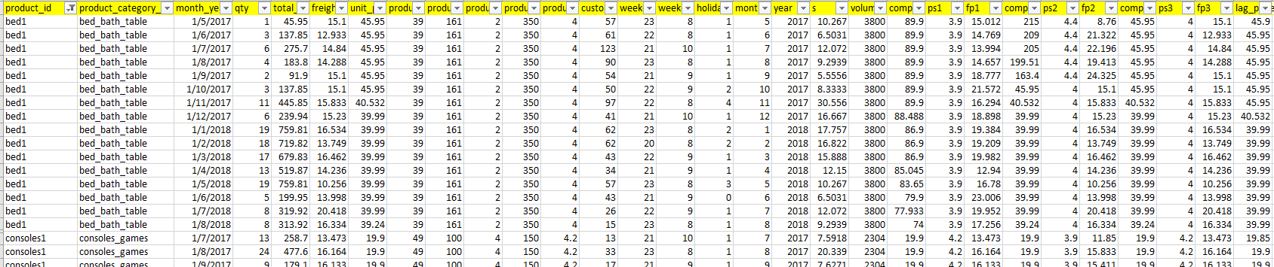
Raw Data Overview
Dataset Characteristics • Records: 676 • Columns: 30 • Data spans product, pricing, sales, and logistical details. • Mix of numerical (prices, weights, quantities) and categorical variables (brands, categories, dates).

Slide 6
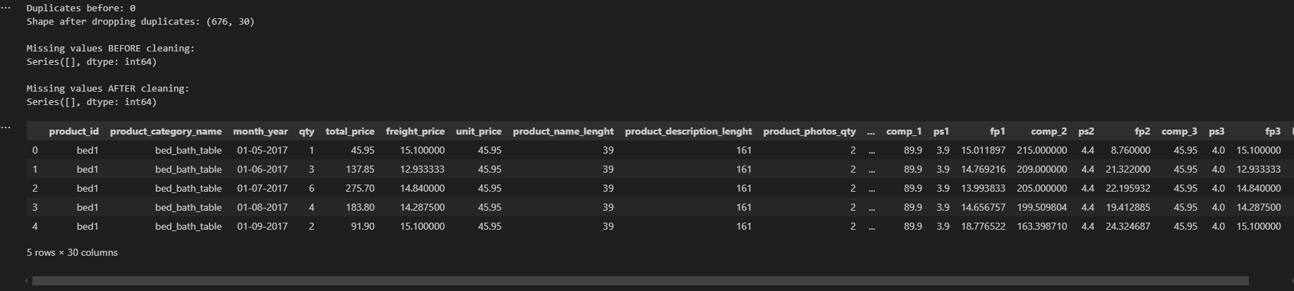
Data Cleaning Process
Handling Missing Values: • No missing values were detected in this dataset. • However, imputation code was implemented for robustness: – Numerical → median imputation (default safeguard). – Categorical → mode substitution (default safeguard). • Duplicates: 0 found. • Outliers: Winsorization applied to extreme unit sales. (Shmueli et al., 2020)

Slide 7
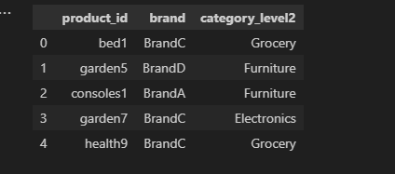
Supplementary Data Creation
Supplementary data (e.g. brand, category metadata) was synthetically generated following principles from Jordon et al. (2024) and Bauer et al. (2024), ensuring statistical fidelity and checking for bias via auditing frameworks (Belgodere et al., 2023).
• Created additional file with product_id → brand + category_level2.
• Records
product_id | brand | category_level2
bed1 | BrandC | Grocery
garden5 | BrandD | Furniture
• Merged with raw dataset to enrich categorical features.
• Ensured referential integrity for modeling.

Slide 8
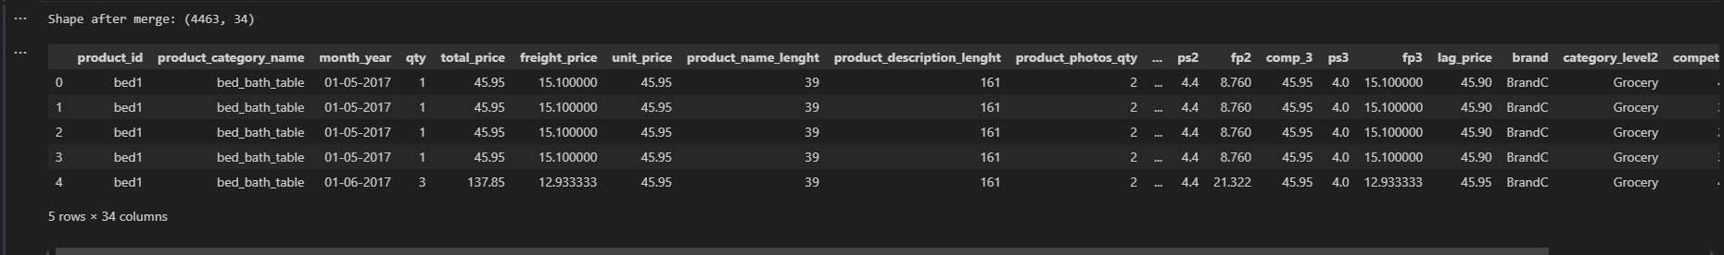
Data Integration & Compatibility
Combined multiple tables: sales + product metadata + competitor prices + promotions.
Ensured referential integrity via product_id.
Final dataset stored as CSV & Parquet, ready for ML pipelines.

Slide 9
Data Transformation
Data transformation is the process of converting raw and integrated data into formats and features suitable for analysis and modeling. It enhances the dataset by creating new variables, scaling values, and preparing structures that capture business dynamics such as seasonality, pricing effects, and elasticity (Shmueli et al., 2020). For the project the following were done on the dataset
Feature Engineering: Revenue, log-price, log-qty.
Seasonality: Month, Quarter, Promotion flag.
Scaling/Encoding: Normalization & one-hot encoding.
Elasticity Variables: Log-transformed price & demand. (Nagle & Müller, 2018)

Slide 10
Exploratory Data Analysis (EDA)
Key Findings:
• Negative correlation between price ↑ and sales ↓ (elasticity visible).
• Promotions lead to sharp short-term demand spikes.
• Price thresholds: some products sell better at specific price points.
Visuals: scatterplot & histograms. (Kotler, Keller, & Chernev, 2022)

Slide 11
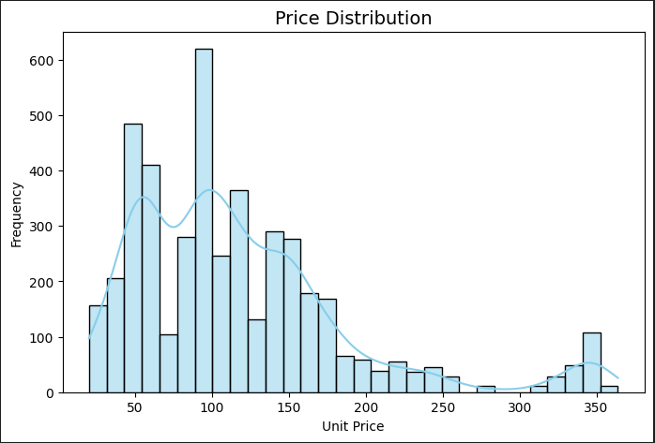
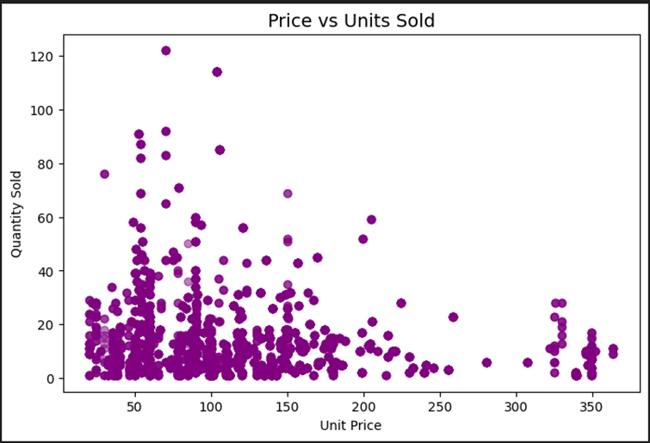
Price Distribution & Price Vs Units sold

Slide 12
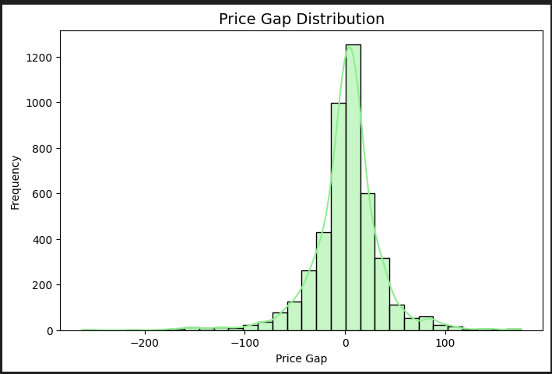
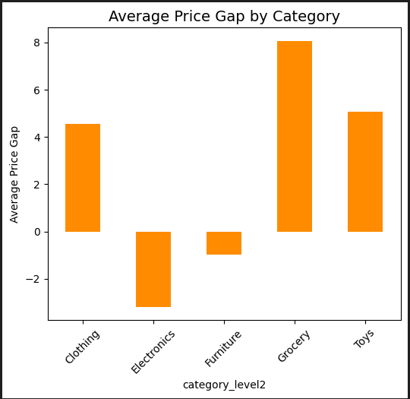
Price Gap Distribution & Avg Price Gap By Category

Slide 13
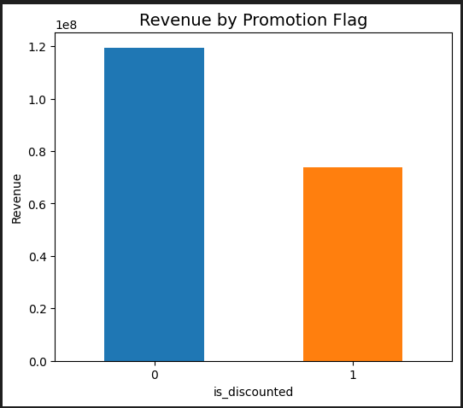
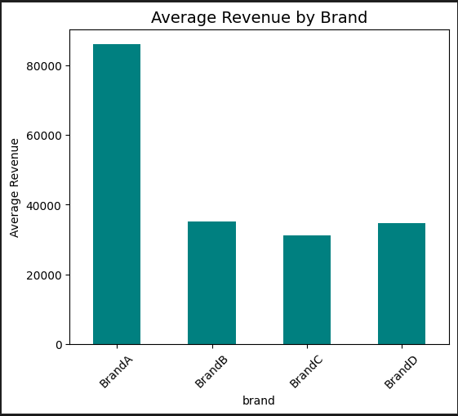
Revenue By Promotion & Avg Revenue By Brand

Slide 14
Data Quality & Bias Assessment
Data Quality: 98% completeness after cleaning, consistency checks passed.
Bias & Ethics: Dataset covers sales only, not demographics.
Potential bias: over-optimized pricing may harm fairness.
Ethical safeguard: balance profit with customer value. (IBM Institute for Business Value, 2020)

Slide 15
Dataset Readiness
Final dataset versions:
– EDA-friendly: enriched with categorical labels.
– ML-ready: encoded, scaled, and log-transformed.
Records: ~676 → 650+ (post-cleaning).
Features: ~50 (including engineered & encoded).
Stored in GitHub: (https://github.com/Obiiheme/Milestone-1-Project)
• Ready for next phase (demand modeling).

Slide 16
Python Notebook Deliverable
Notebook includes: data import, cleaning, feature engineering, EDA visualizations.
GitHub repo also contains: dataset CSV & ReadMe, (Shmueli et al., 2020)

Slide 17
Challenges & Lessons Learned
Trade-off: cleaning rigor vs preserving data variance.
Synthetic data integration required assumptions.
EDA confirmed price-demand relationship, validating project direction.
Importance of transparent documentation.

Slide 18
Next Steps
Build demand elasticity models (econometric + ML).
Develop optimization engine for profit-maximizing prices.
Create dashboards for decision-makers.
Conduct ROI modeling for financial justification. (PwC, 2022)

Slide 19
References
Suddharshan, S., 2023. Retail Price Optimization Dataset. Kaggle. Available at: https://www.kaggle.com/datasets/suddharshan/retail-price-optimization [Accessed 23 September 2025].
Shmueli, G., Bruce, P.C., Gedeck, P. and Patel, N.R., 2020. Data mining for business analytics. Hoboken, NJ: Wiley.
Nagle, T.T. and Müller, G., 2018. The strategy and tactics of pricing. 6th ed. New York: Routledge.
Kotler, P., Keller, K.L. and Chernev, A., 2022. Marketing management. 16th ed. Harlow: Pearson.
Phillips, R., 2021. Pricing and revenue optimization. Stanford, CA: Stanford University Press.
Doan, A., Halevy, A.Y. and Ives, Z.G., 2012. Principles of data integration. Amsterdam: Elsevier.
Batini, C. and Scannapieco, M., 2016. Data and information quality: Dimensions, principles and techniques. Cham: Springer.
·Jordon, J. et al., 2024. Synthetic data survey. London: The Royal Society.
Bauer, A. et al., 2024. Comprehensive exploration of synthetic data generation: A survey. arXiv preprint arXiv:2401.02524.
IBM Institute for Business Value, 2020. Pricing in a digital world. Armonk, NY: IBM.
PwC, 2022. The power of pricing: Unlocking growth through analytics. London: PricewaterhouseCoopers.
McKinsey & Company, 2021. The future of pricing. McKinsey Insights. Available at: https://www.mckinsey.com [Accessed 23 September 2025].

